Slide 1

CSC 533: Privacy in the Digital Age (Fall 2023) Final Exam : Review
Anupam Das
Dec 05, 2023

Slide 2
Final Exam format
Format
Short questions (total around 8 questions + 1 bonus)
90 mins (In class)
Date and Time: Dec 07, 2023 from 8:30 am
Only post midterm content
Template questions for you to better prepare (similar to midterm):
Explain how approach X works? How would you use X under a given scenario Y?
What are the limitations of X and how does Y resolve it?
Demonstrate how X works. [with illustrative example]
Construct a solution for the following scenario. Open-ended questions.
Compare X with Y under this scenario.
What is the difference between X and Y?
Important: Look at assignments and class discussions

Slide 3
Review Topics
* Privacy attacks on ML (model inversion attack, property inference attack, model extraction attack, and membership inference attack) * Privacy-preserving ML (federated learning) * Achieving fairness and transparency with ML (ways to test for fairness and transparency) * Privacy acts (key concepts and major differences across acts) * Usable privacy notice formats (ways to design privacy notice and their evaluation) * Ways to develop privacy compliance system (approaches discussed to develop usable compliance systems) * Privacy index (Westin's privacy index and its pros and cons) * Different factors that influence privacy decisions and preferences (understanding the factors that are influential) * How bitcoin works and privacy issues that exist (main characteristics and privacy issues) * Network inference attacks (basic concepts of how they work) * Acoustic and motion sensor based inference attacks (basic concepts of how they work)

Slide 4
Privacy Attacks on ML
Privacy Attacks on ML
Attacks on Data
Attribute inference
Property inference
Attacks on Model
Membership inference
Model extraction

Slide 5
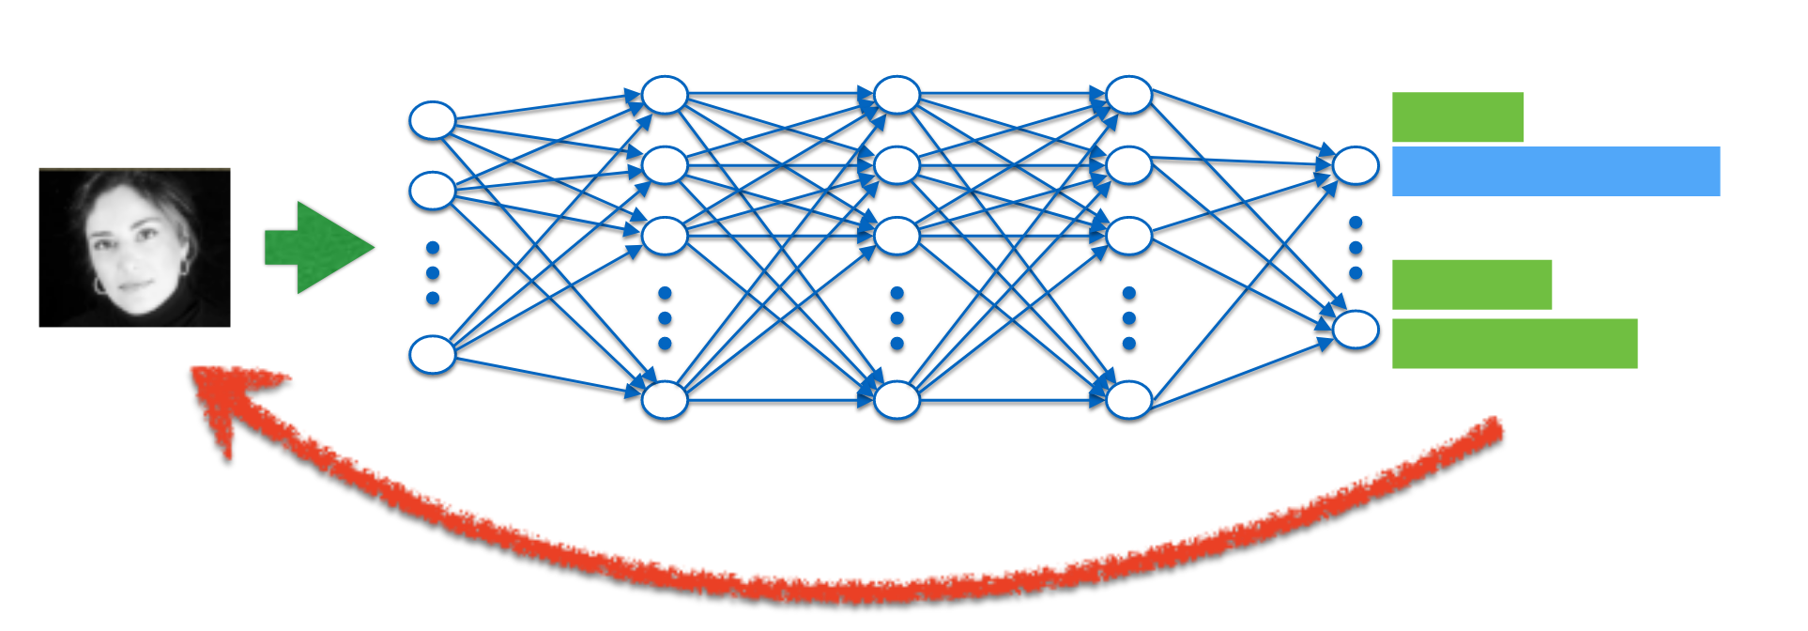
Model inversion / Attribute inference attack
Given an output of a machine learning model, infer something about the input (e.g., sensitive feature of a user)

Slide 6
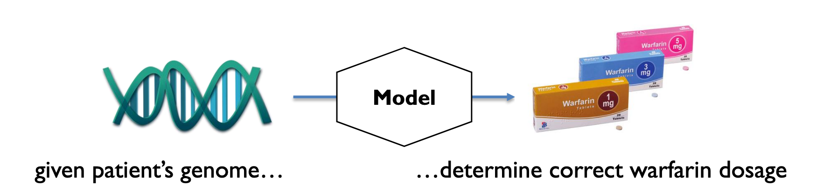
Model Inversion in Action
Privacy breach: given patient’s warfarin dosage, infer information about patient’s genome

Slide 7
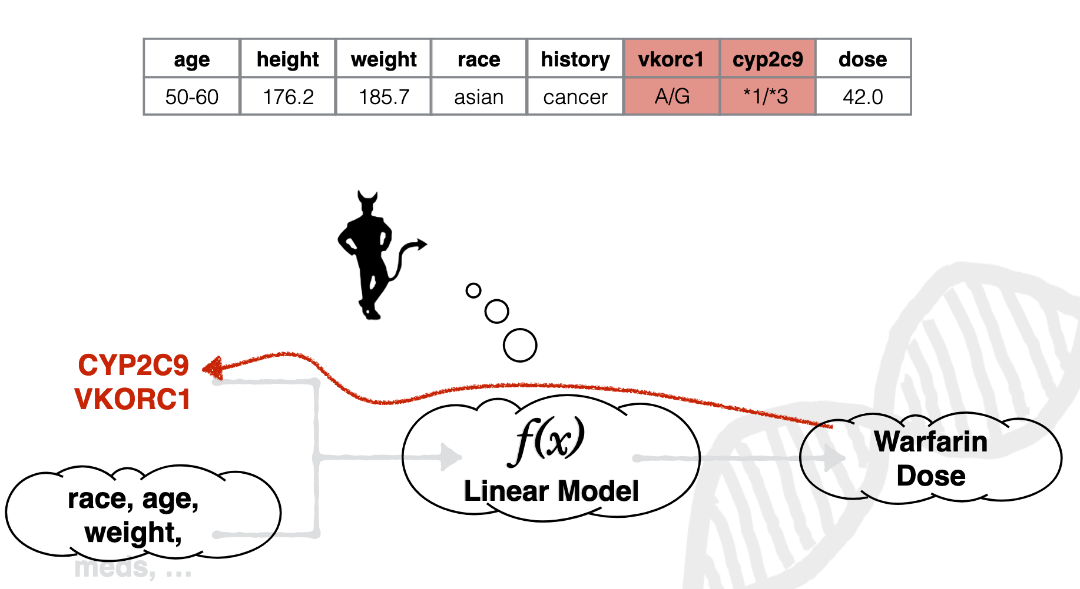
Pharmacogenetic Privacy
Can I predict

Slide 8
Property Inference Attack
The ability to extract dataset properties which were not explicitly encoded as features or were not correlated to the learning task
Extract information learned by the model unintentionally
For example, a classifier identifying gender can also be used to infer if people in the training dataset wear glasses or not.
8

Slide 9
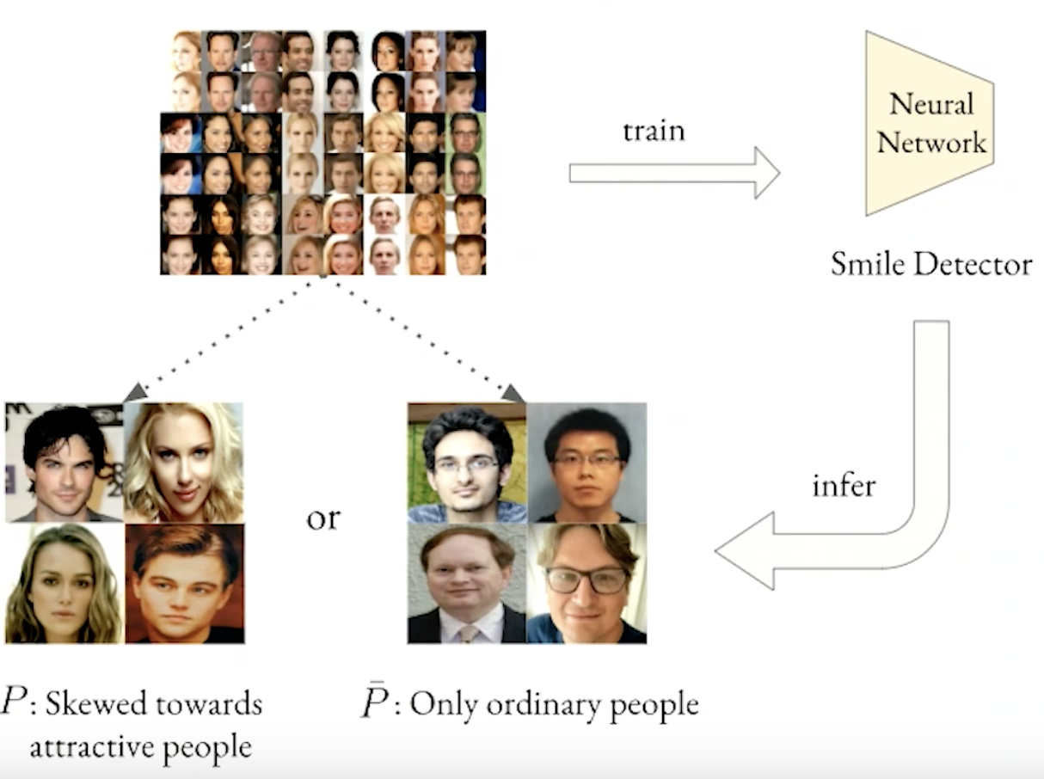
Example
author

Slide 10
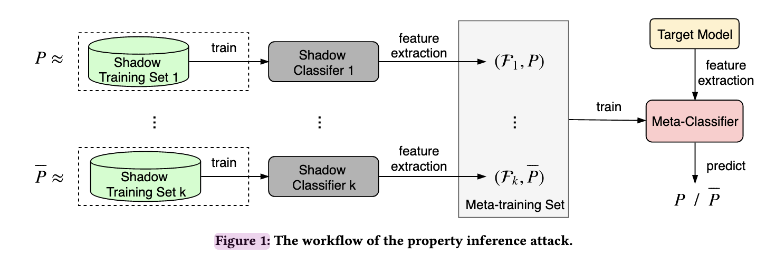
Attack Strategy: Meta Classifier
Attacker has access to the target model (whitebox attack)
Learn the target classifier’s property → Meta classifier
Features are from the classifier itself not data
Meta-classifier simply predicts if target model was trained on dataset that has property P or not

Slide 11
Privacy Attacks on ML
Privacy Attacks on ML
Attacks on Data
Attribute inference
Property inference
Attacks on Model
Membership inference
Model extraction

Slide 12



Model Extraction Attacks
Goal: Adversarial client learns close approximation of f using as few queries as possible
Applications:
Undermine pay-for-prediction pricing model
Facilitate privacy attacks
Stepping stone to model-evasion [Lowd, Meek – 2005] [Srndic, Laskov – 2014]
Target: f(x) = f’(x) on ≥ 99.9% of inputs
Attack
x
Model f
Data
f’
f(x)
Notes:
Use extracted model as a stand-in for white box attacks, such as …

Slide 13

Model Extraction Example: Logistic Regression
Goal: Adversarial client learns close approximation of f using as few queries as possible
f(x) = f’(x) on 100% of inputs
Alice
Attack
x
Model f
Data
f’
f(x)
Bob
f (x)
= 1 / (1+e ^{-(w*x + b)})
f (x)
ln
( )
= w*x + b
Linear equation in
n+1 unknowns w,b
1 - f(x)
Query n+1 random points ⇒ solve a linear system of n+1 equations

Slide 14
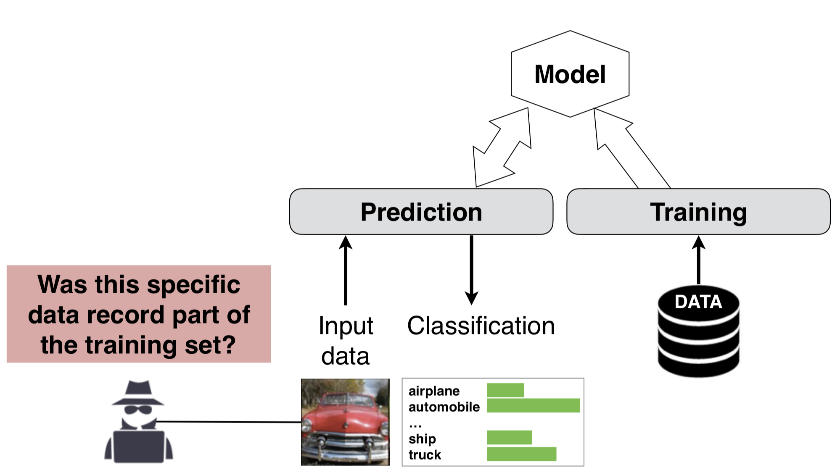
Membership inference attack

Slide 15
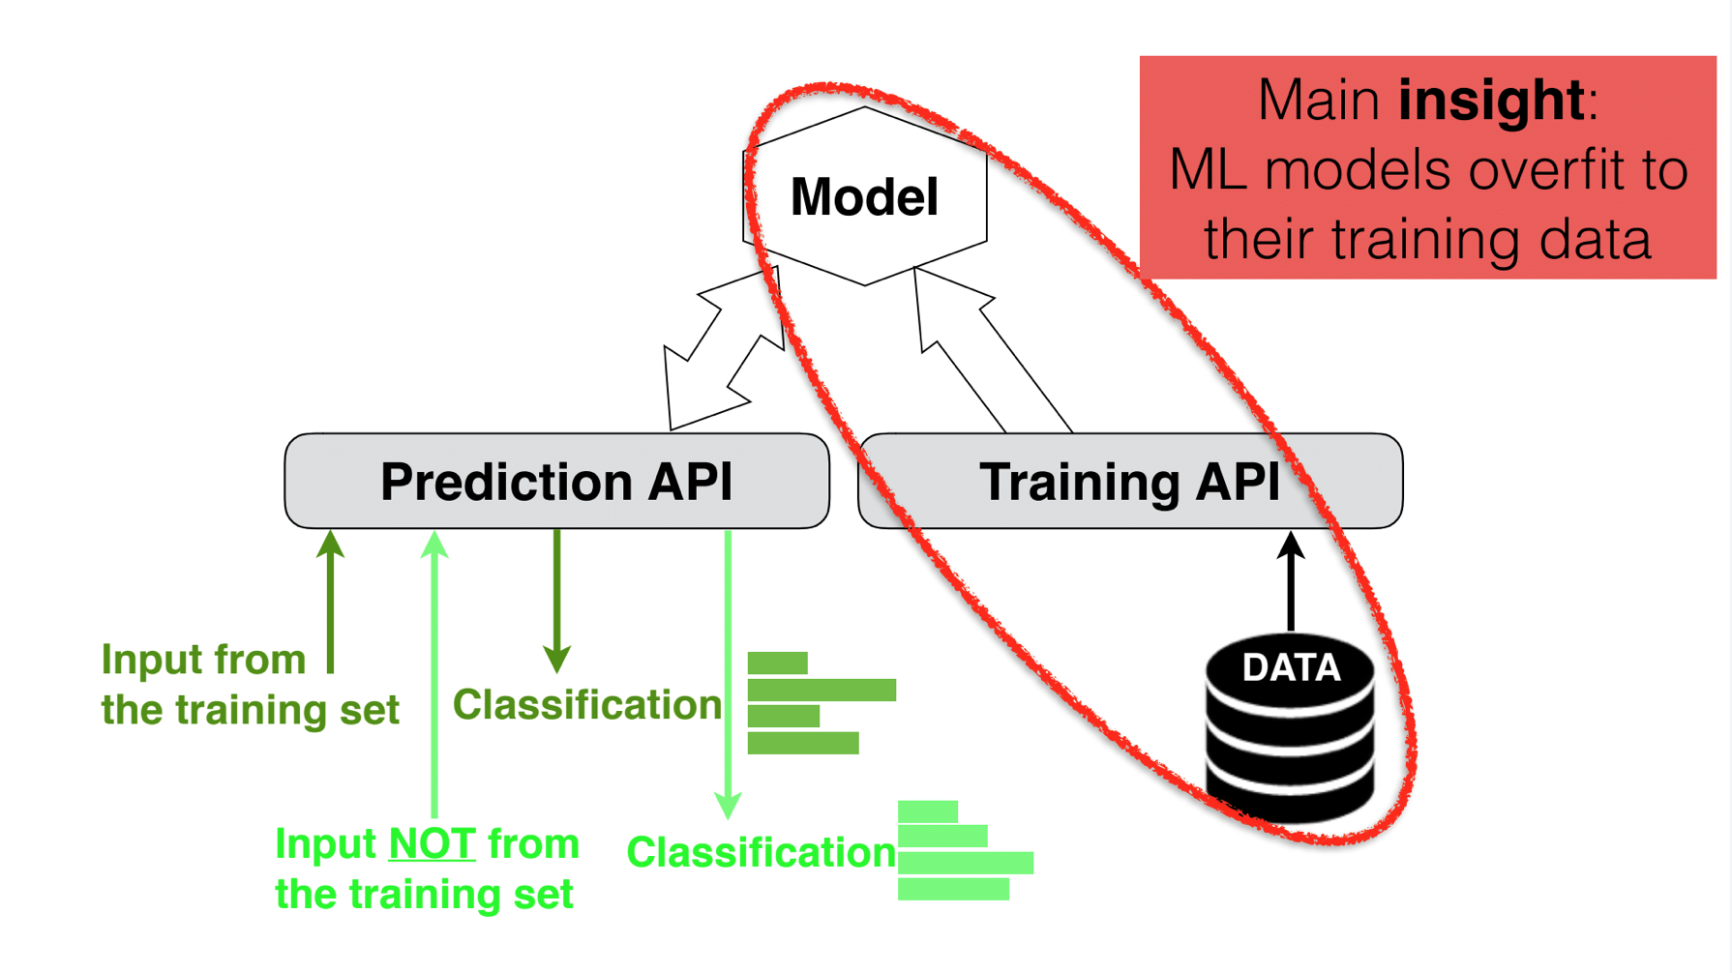
Attack Overfitted Models

Slide 16
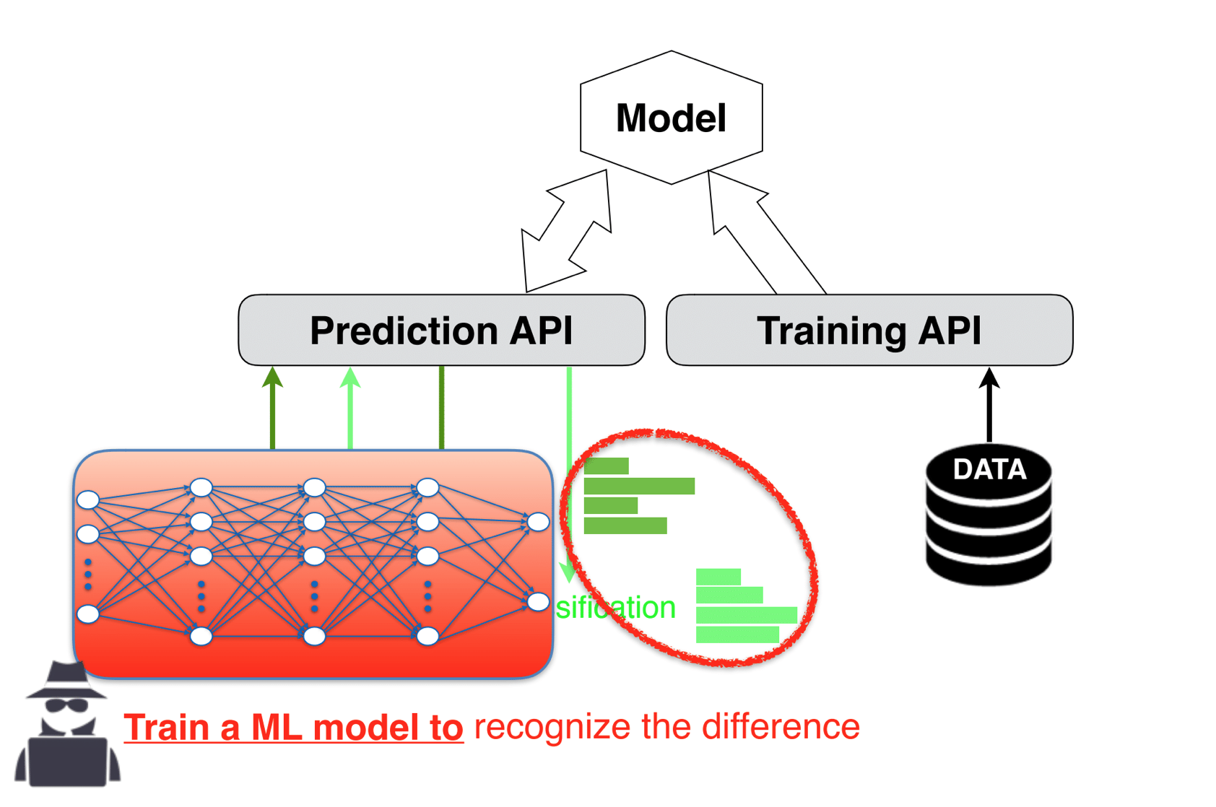
ML against ML

Slide 17
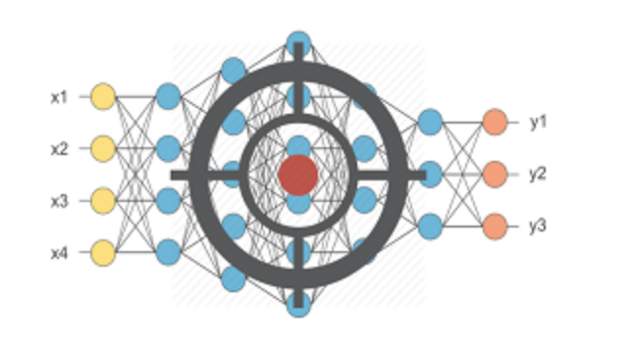
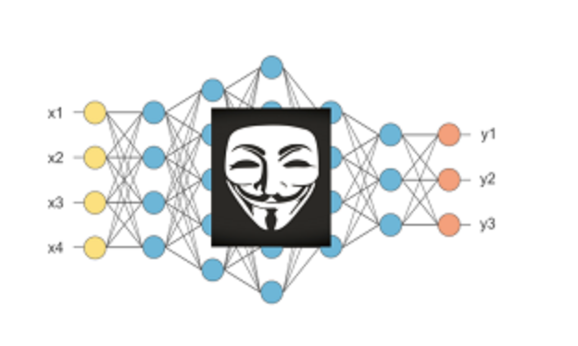
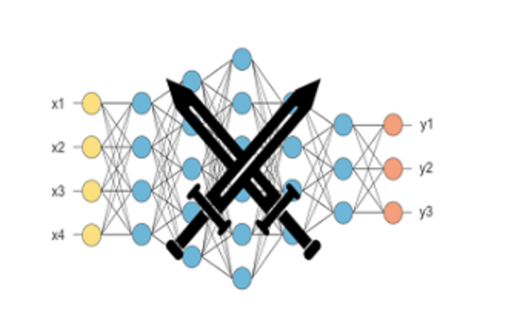
Different Models needed
Target Model (the one that a cloud service build’s):
Input: Data that you want to analyze
Output: Class prediction probability and final prediction
Shadow Model:
Input: Data from the same input distribution
Output: Class prediction probability and final prediction
Attack Model:
Input: class prediction probability
Output: member or not-member

Slide 18
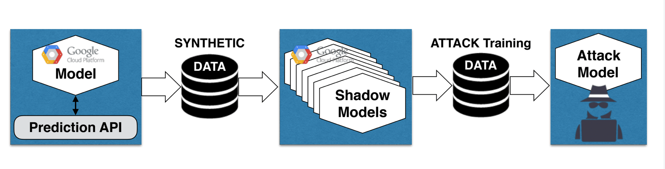
Constructing the Attack Model
Step 1: Generate Synthetic Data
Step 2: Train Shadow Models
Step 3: Train the Attack Model
Membership Inference Attacks Against Machine Learning Models. Reza Shokri ; Marco Stronati ; Congzheng Song ; Vitaly Shmatikov IEEE SP 2017

Slide 19
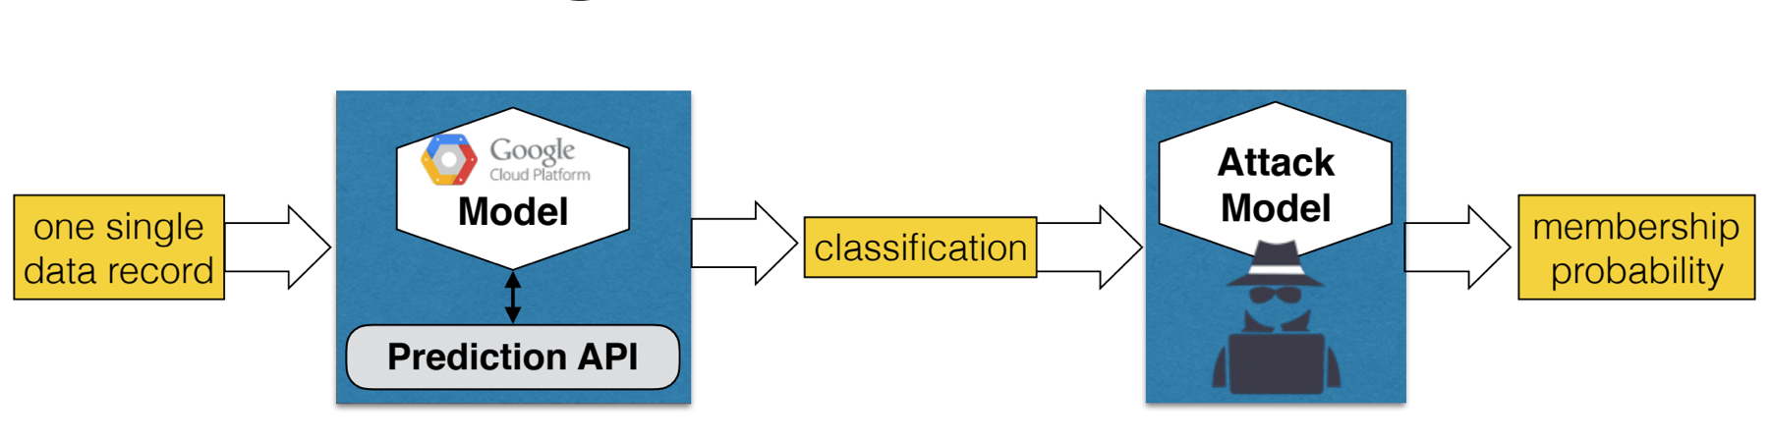
Using the Attack Model
Step 1: Get the prediction vector on the target record
Step 2: Get the prediction of the attack model

Slide 20
Topics
Federated learning

Slide 21






Distributed / Federated Learning
Multiple clients want to collaboratively train a model
Server
Gboard
Tensorflow Federated

Slide 22
Distributed / Federated Learning
In each iteration
Multiple clients want to collaboratively train a model
Server
Download global model from server

Slide 23
Distributed / Federated Learning
In each iteration
Multiple clients want to collaboratively train a model
Server
Share model updates
Sharing updates rather than data...
Train on a batch

Slide 24
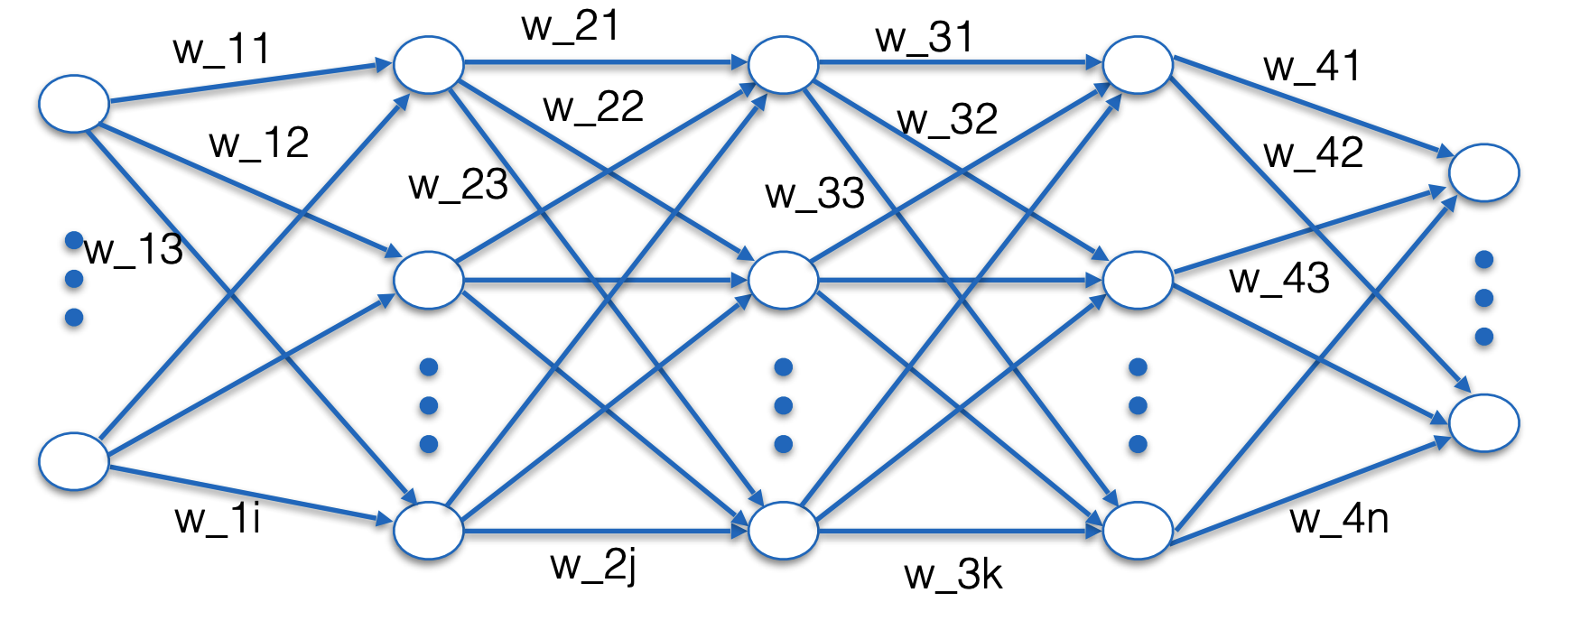
Parameter Training using SGD
Find parameters that minimize the classification error

Slide 25
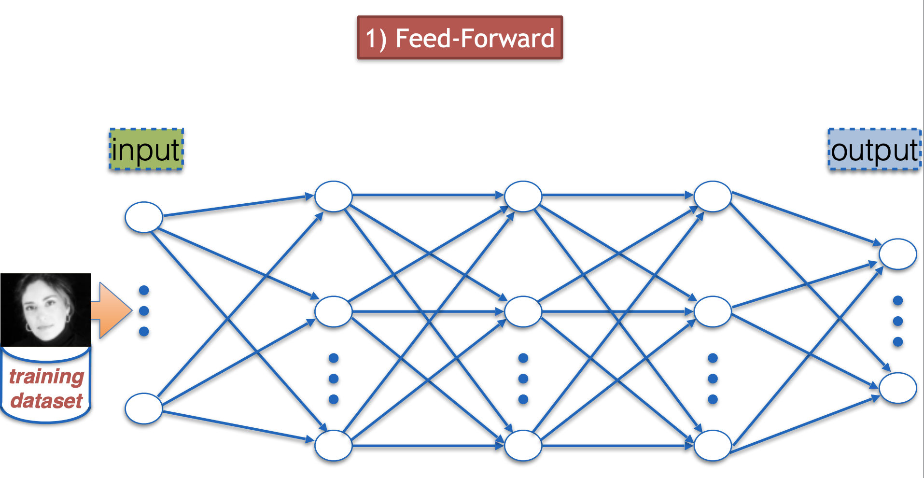
Parameter Training using SGD
Randomize the weights
Insert input and check output

Slide 26
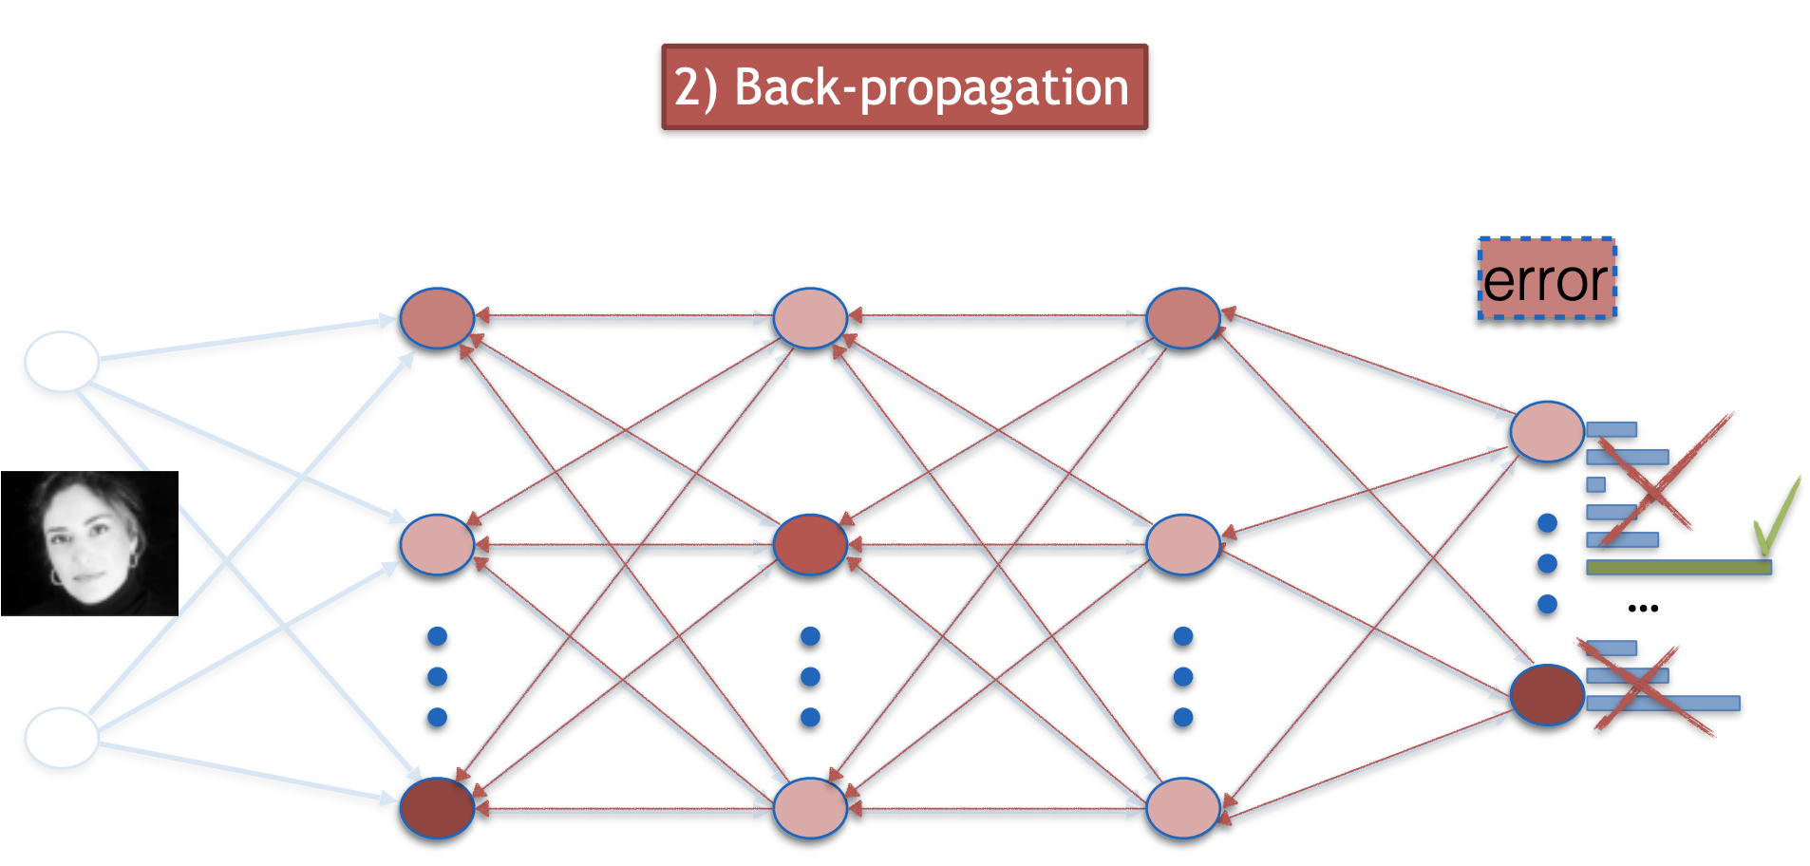
Parameter Training using SGD
Compare against expected output (error)

Slide 27
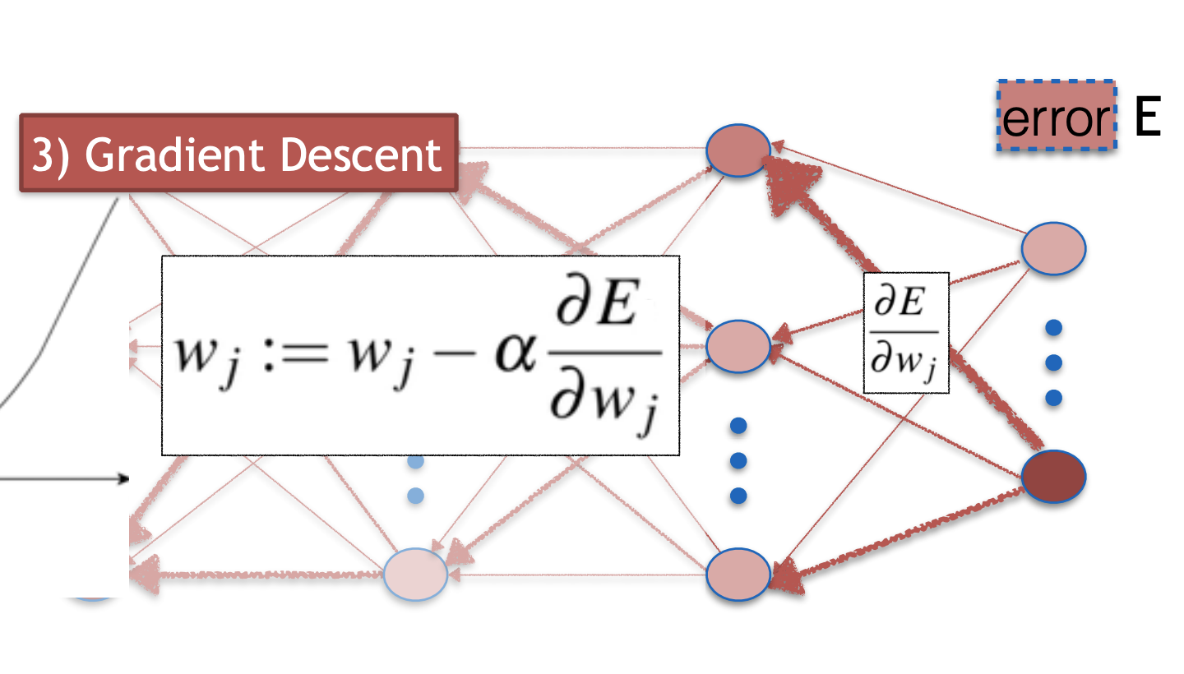
Stochastic Gradient Descent
Update weights proportional to error

Slide 28
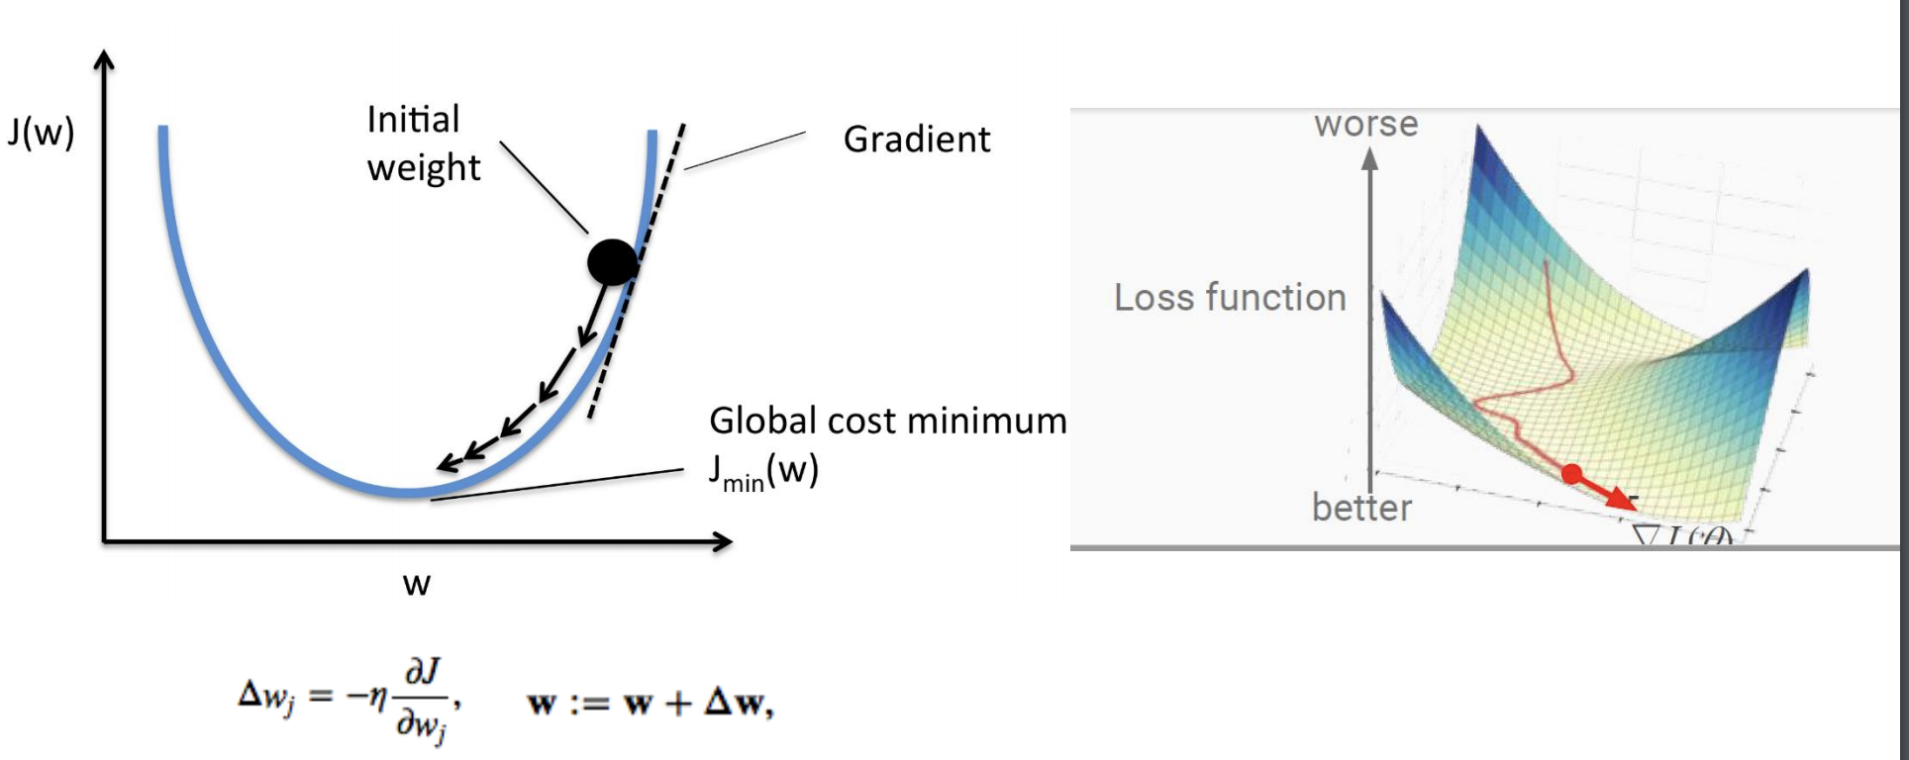
Stochastic Gradient Descent

Slide 29
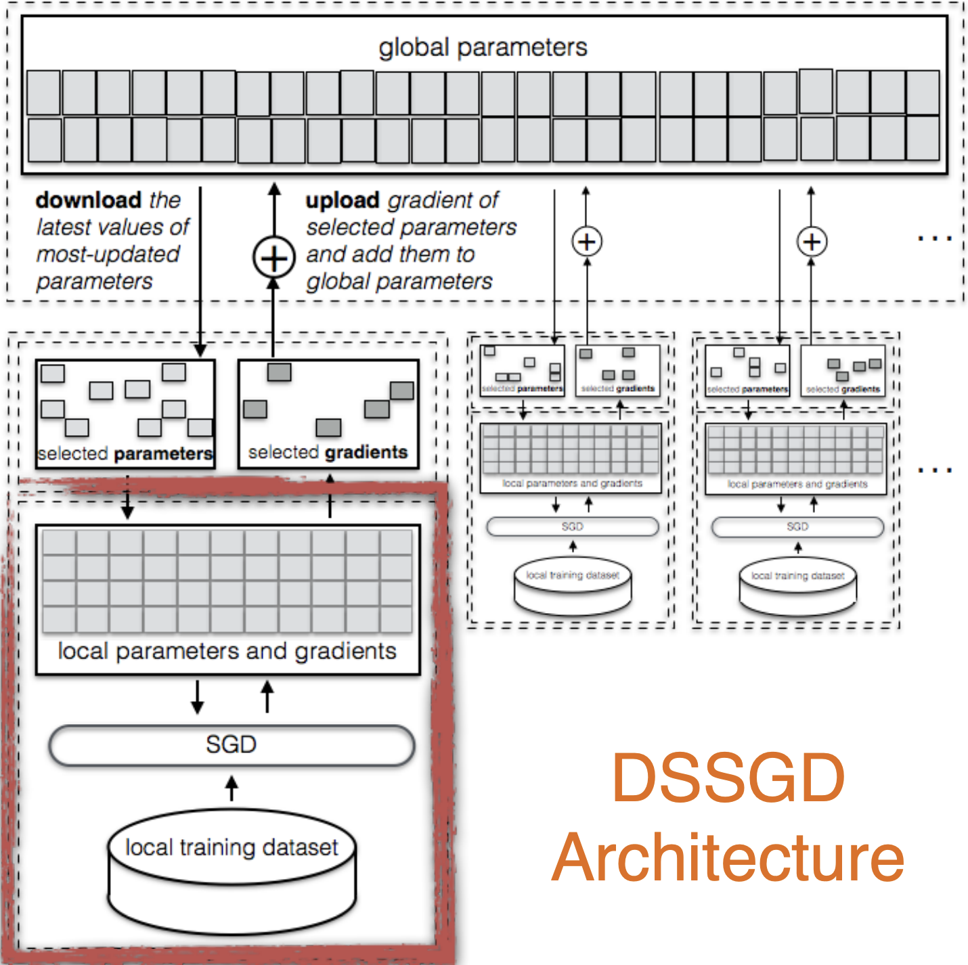
Overall architecture
Each node locally trains the model
Computes gradients for each parameter (weight)

Slide 30
Topics
Fairness and Transparency in ML

Slide 31

1st Attempt: Fairness through blindness
Ignore all irrelevant/protected attributes
E.g., “We don’t even look at ‘race’!”
You don’t need to see all attribute to be able to predict it with high accuracy

Slide 32
2nd attempt: Statistical Parity
S : Protected subset
S^{c} : Rest of the population
S
Check if the probability of the outcome is similar across groups
Pr(Outcome|S) ≅ Pr(Outcome|S^{c} )
S^{C}
“Fraction of people in S getting loan same as in S^{c}”.
When we make an error, the direction of that error is equally likely for both groups
P(loan|no repay, S) = P(loan|no repay, S^{c})
P(no loan|would repay, S) = P(no loan|would repay, S^{c})
Population

Slide 33
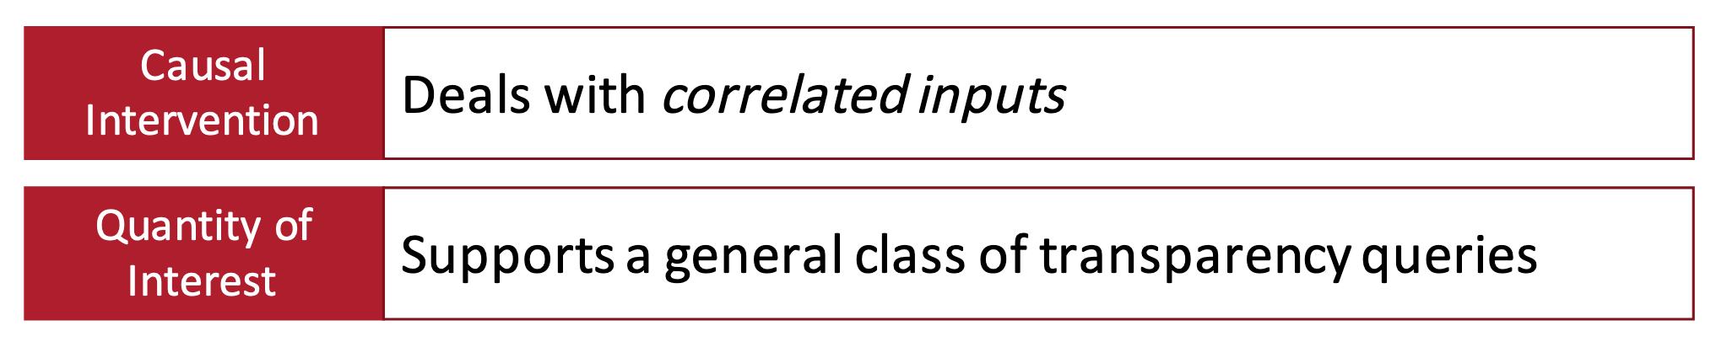
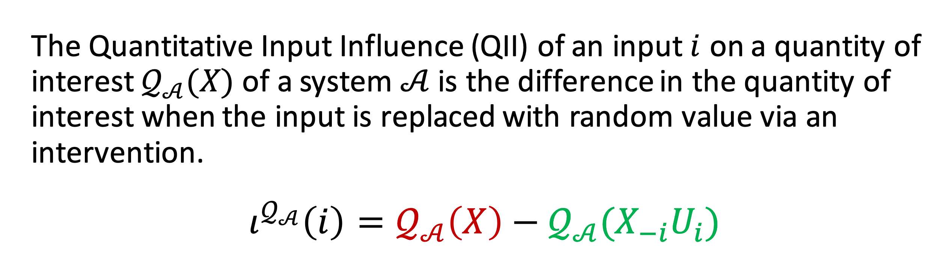
Transparency: Quantitative Input Influence (QII)
A technique for measuring the influence of an input of a system on its outputs. Can enable -

Slide 34
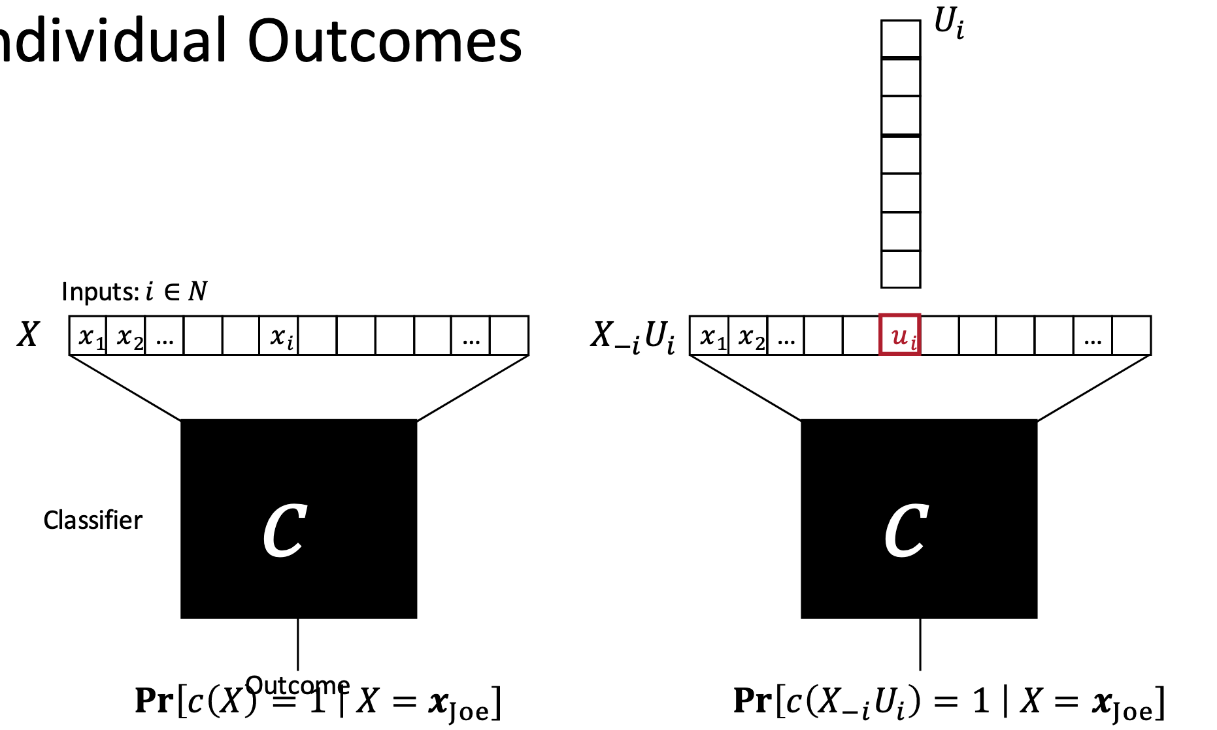
QII for individual feature
Causal Intervention: Replace feature with random values from the population, and examine distribution over outcomes.
Outcome
Input feature values

Slide 35
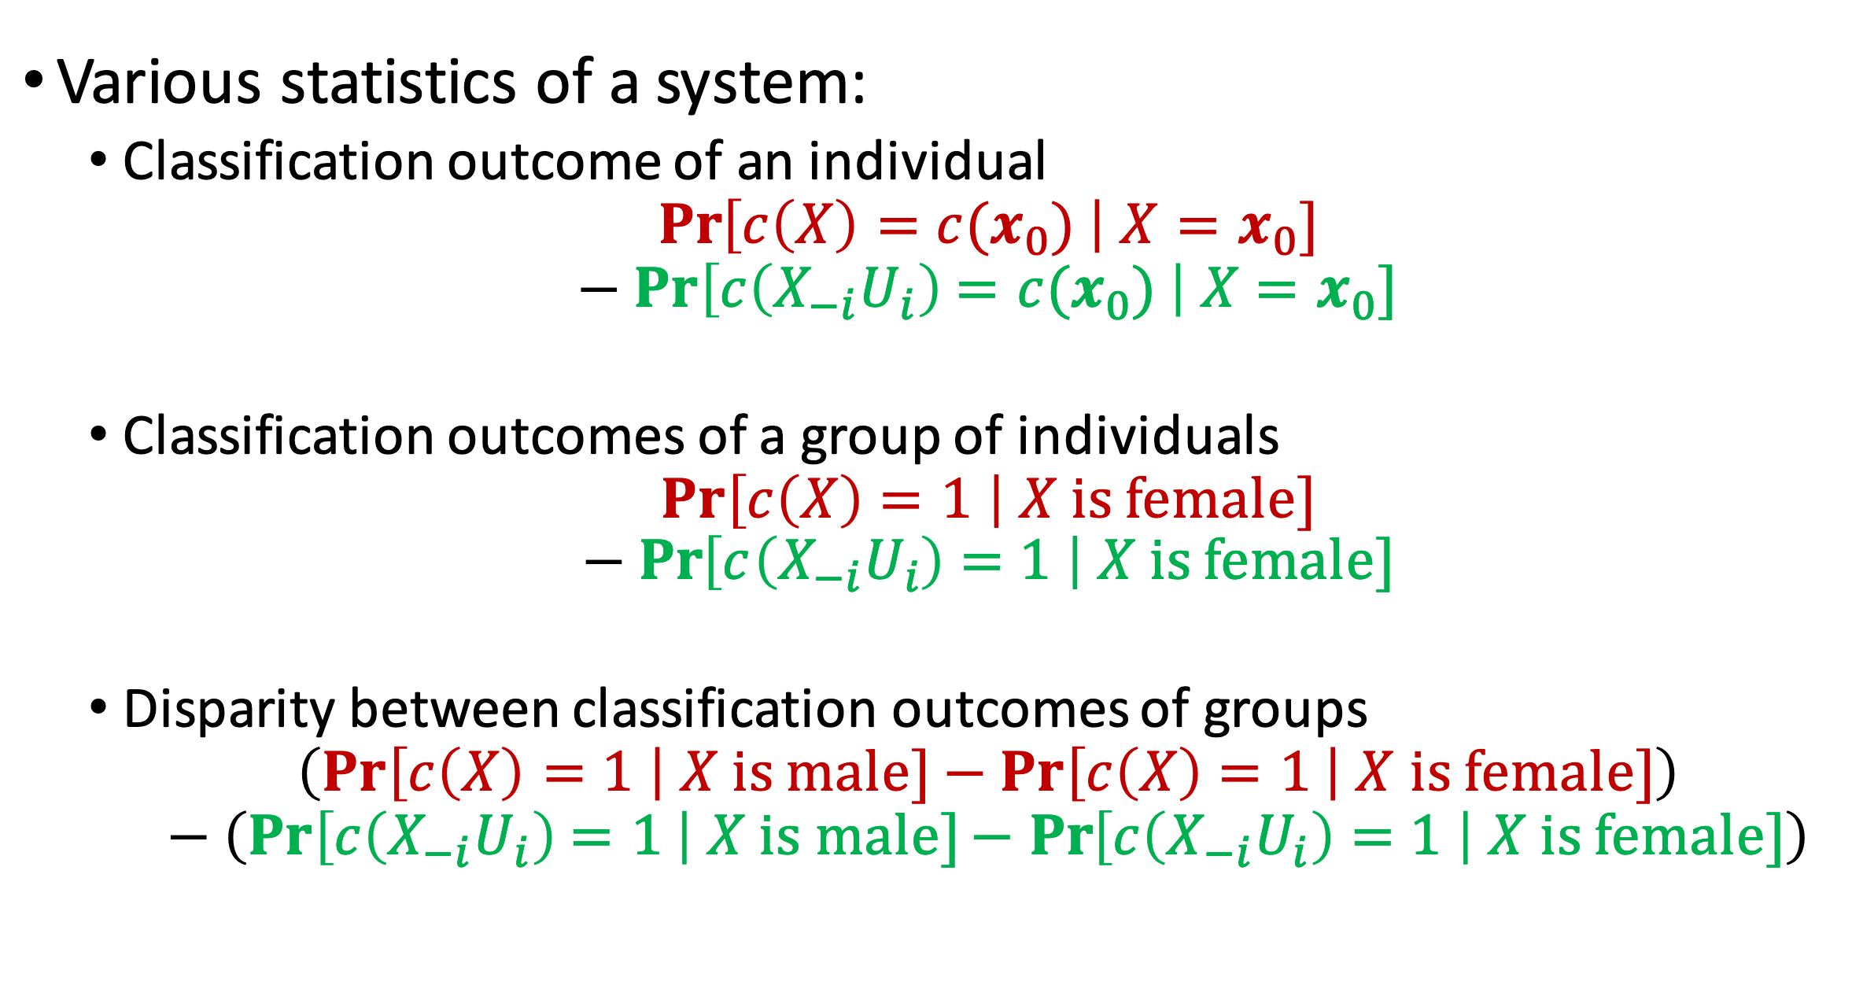
Quantity of interest

Slide 36
Topics
Privacy Acts

Slide 37
Things to learn
Learn the basics of the following privacy acts
HIPPA
FERPA
COPPA
GDPR
CCPA
Understand what the act is for and what it tries to protect, when it applies and consequences of violation

Slide 38
Topic
Privacy notice design

Slide 39
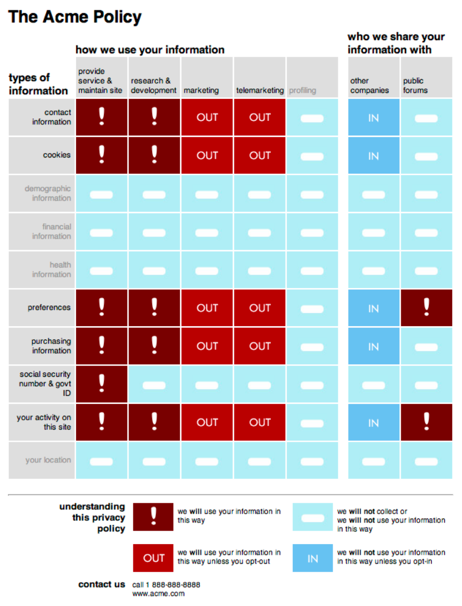


Different format for Privacy notice

Slide 40
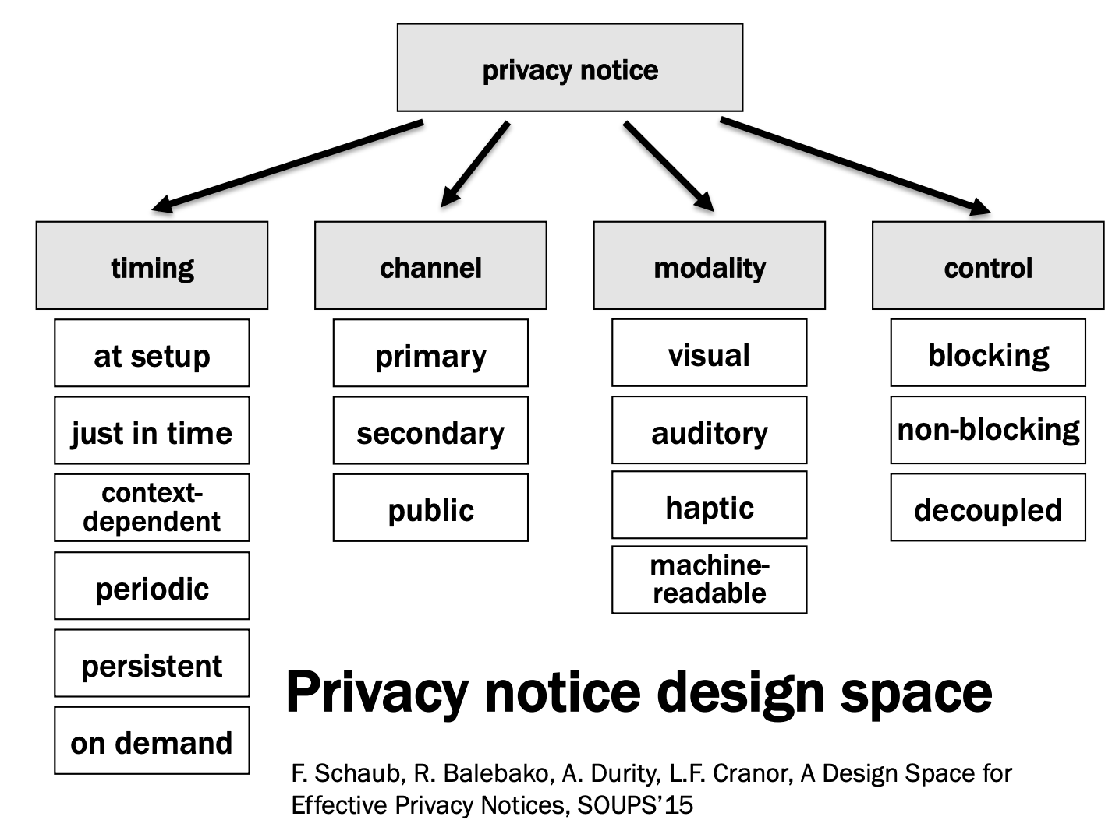
Privacy notice design space

Slide 41

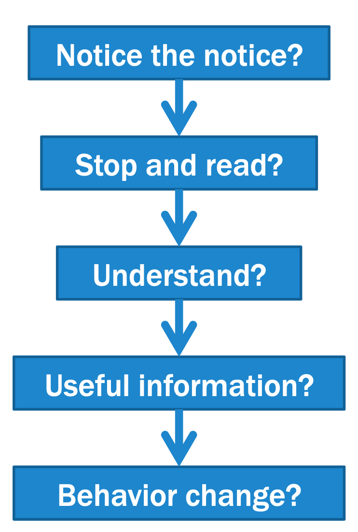

How do we measure effectiveness?
By what criteria should we measure effectiveness?

Slide 42
Topic
Factors that influence users' privacy preference

Slide 43
Privacy factors
Anonymization
Data usage details
Default encryption
Fine-grained control
Time and space limited storage
Policies and laws
Past experience or exposure
Cultural background
Geolocation

Slide 44
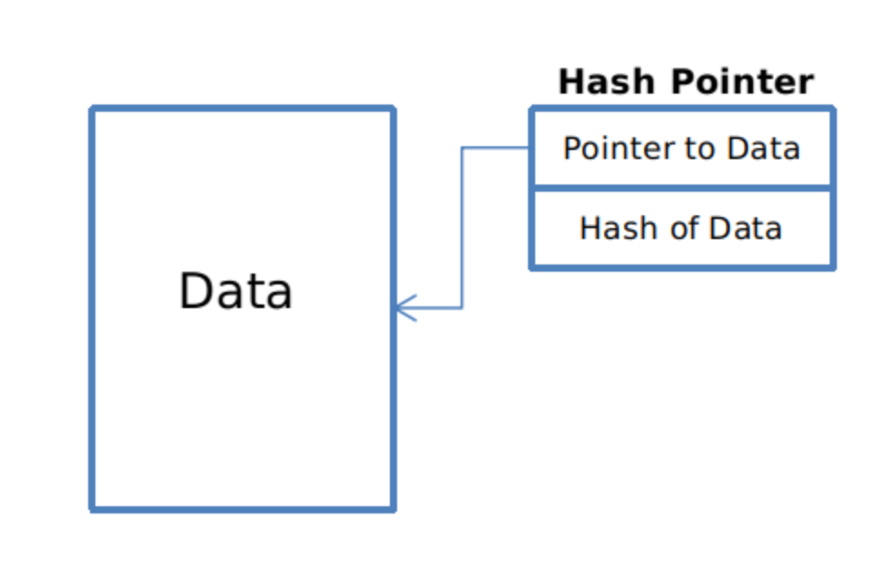
Hash pointers
hash pointer is:
* pointer to where some info is stored, and
* (cryptographic) hash of the info
if we have a hash pointer, we can
* ask to get the info back, and
* verify that it hasn’t changed
H( )
(data)
will draw hash pointers like this
44

Slide 45
Blockchain of hash pointers
H( )
linked list with hash pointers = “block chain”
prev: H( )
prev: H( )
prev: H( )
data
data
data
use case: tamper-evident log
45

Slide 46
Detecting tampering
H( )
prev: H( )
prev: H( )
prev: H( )
data
data
data
use case: tamper-evident log
46

Slide 47
Double spending attempts
1 confirmation
3 confirmations
C_{A} → B
Double-spend probability decreases exponentially with # of confirmations
Most common heuristic: 6 confirmations
Works only if 50% of the nodes are honest
C_{A} → A’
double-spend attempt
Honest nodes will extend the longest valid branch

Slide 48
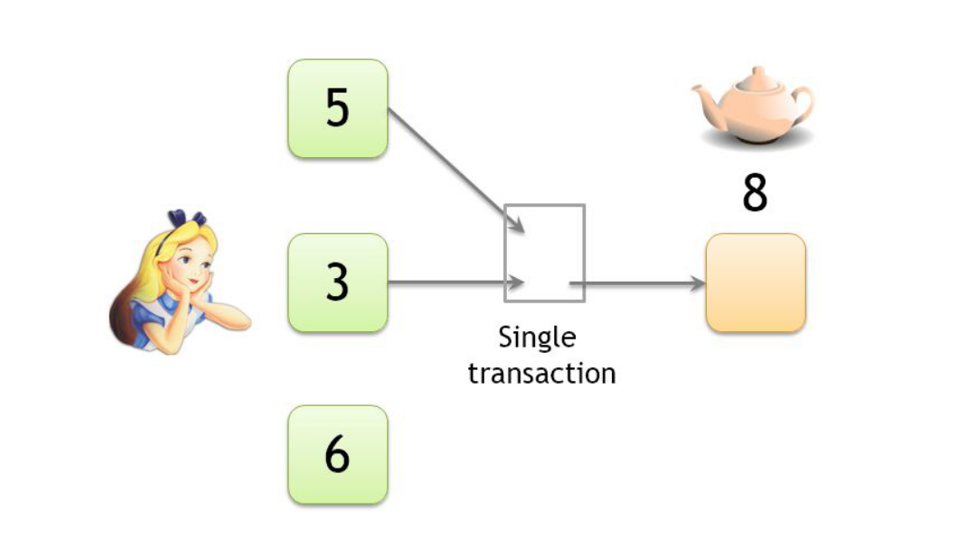
Privacy issue: Linking pseudonyms
Both inputs must belong to the same person
The wallet will require the keys to generate the transaction
Lecture: https://youtu.be/glyQy_e5LmM?t=1758

Slide 49
Topics
Network inference attacks

Slide 50
Logistics
Class evaluation (please complete)
Survey link => http://go.ncsu.edu/cesurvey
Go and fill out the survey after class (requires 2-3 mins)

Slide 51
Course feedback
What things you like?
What things you didn’t like?
Topic suggestions?

